Slide 1
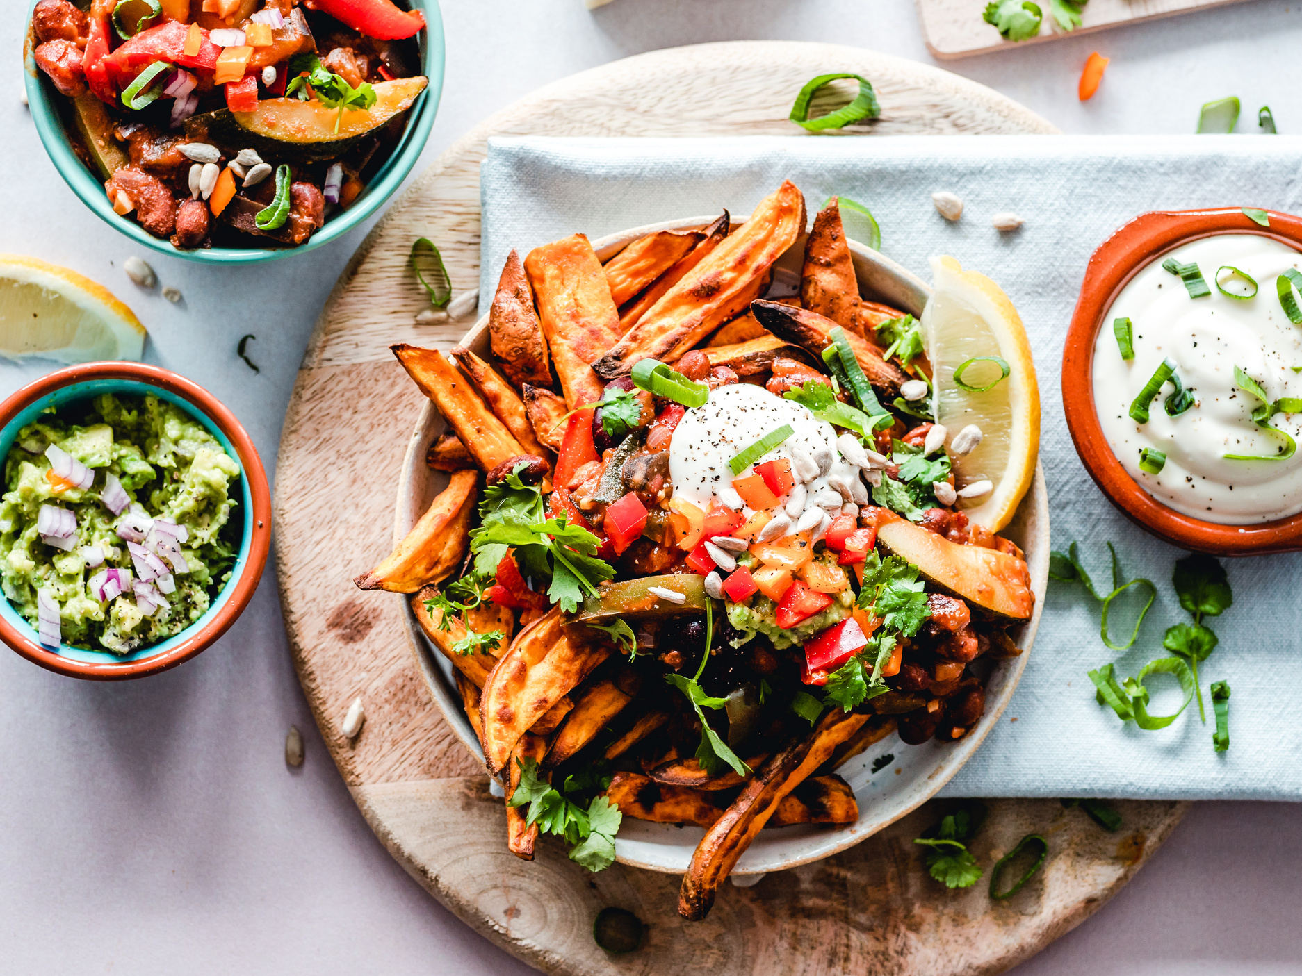

Better Experience
With Food Ordering
ORDERED
No more indecision about what to eat
Presented by Bon Appétit
Notes:
How often do you use the delivery app？
Once you open the app? Have you ever struggling with ordering, seeing tons of options but have absolutely no idea about what to order?
We are Bon Appetit, a food delivery app bringing the world's flavors to you

Slide 2

Table of content
1
Introduction & Background
2
Hypothesis & Method
3
Glance on Data & Testing Results
4
Advice & Limitations
5
Appendix
Notes:
For today's presentation, we will go through 5 parts step by step...

Slide 3
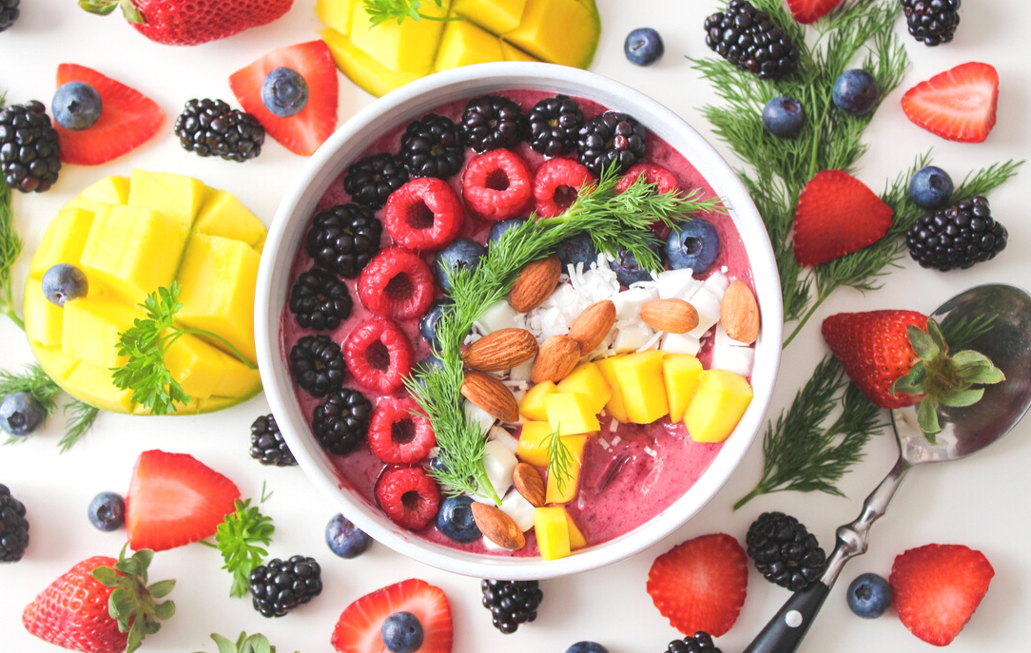



Introduction
We are a food delivery app dedicated to:
Provide convenient and reliable food delivery service
Continuously improve overall customer experience
Have you EVER?
Display VALUE-ADDED Label
Time Efficient Decision
Best Meal
Customer Satisfaction
Notes:
Link back to 2 questions I asked as the beginning of the presentation, as bon appetit is an APP dedicated to
-Provide convenient and reliable food delivery service that connects customers with their favorite restaurants
-Ensure high-quality food, exceptional customer service, and timely delivery.
-Use technology to continuously improve service, streamline the ordering process, and enhance the overall customer experience.
With those visions, we have the solution for your!
we are planning to launch a value-added label to our app to help customers make time efficient decisions, enjoy world-class meals and get excited about the next order

Slide 4
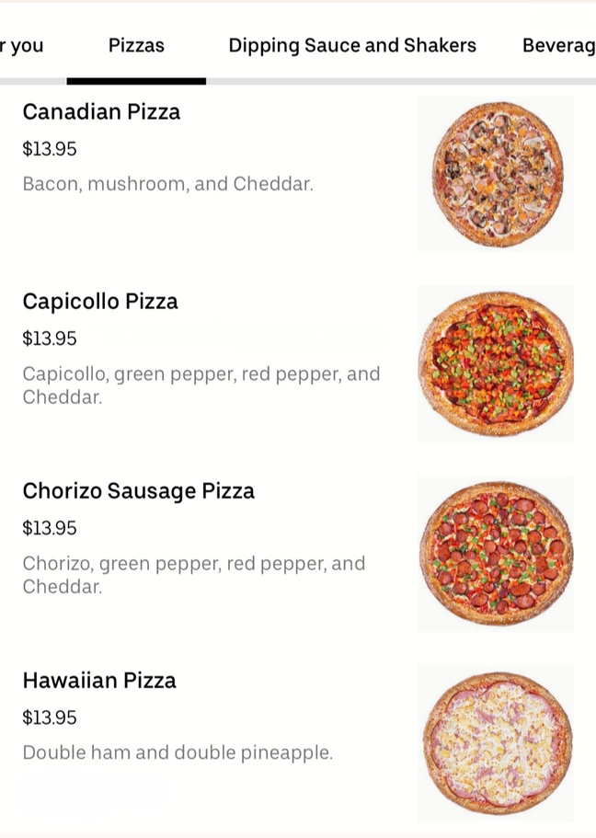
Background
- Current Interface
Hard to make decisions
Increase costs
Customer dissatisfaction
Notes:
With current user interface, Customers may have to spend more time browsing through the menu and reading descriptions of dishes, trying to identify popular items. Which can then lead to increase in cost wrt time and money
Moreover, too much options without the information about the popularity of certain dishes, customers may be unsure about what to order, leading to indecision and frustration.

Slide 5
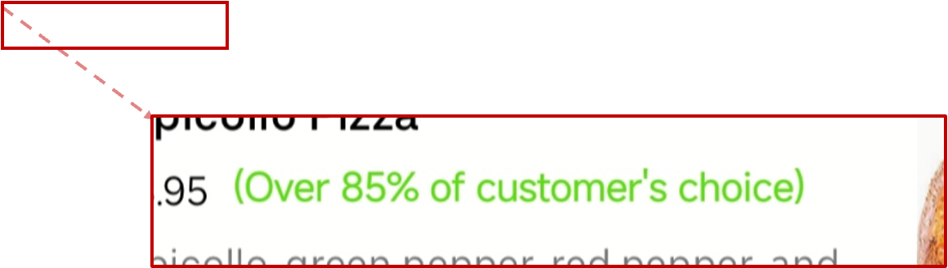
Background
- Tested Interface
Attract attentions
Reduce chance of disappointment
Time efficient decisions
(Over 85% if customer's choice)
Notes:
On the other hand, once the new interface with customer's top choice is displayed at the APP, it will immediately catch the eye of customers which allow them quickly identify popular dishes that are frequently ordered by other users, making it easier for them to choose what to order, making them confident for their choice since the dish has already been tried and tested by many other customers can which can reduce the risk of ordering a dish that may not meet their expectations.
With such handy feature, customers can then make time-efficient decisions without spending too much time browsing through the menu.

Slide 6



Hypothesis
Affects order conversion rate
Store Level
Dish Level
Affects order conversion rate from different label magnitude
.
55% vs 70% vs 85%
Education
People
DISPLAYING OTHER USERS' CHOICES
Affects order conversion rate depending on
Income
Ordering Frequency
Other Demographics
Goals in Life
Notes:
Whether displaying other users’ choices or not is our independent variable. We would like to conduct an analysis from three dimensions. Firstly: We have two dependent variables. One is the ordering rate at the store level and the other is the ordering rate for the dish with the label beside it. We want to know if displaying other users’ choices next to the dish brings an impact on the two dependent variables.
Secondly, we want to conduct a test to confirm if different label magnitude: whether showing 55%, 70%, or 85% of customer’s choices would show a significant difference in our two dependent variables.
The third dimension of the hypothesis is to conduct an analysis on if such labeling effects on order conversion rate depend on other moderators, for example, income level, education level, food delivery app usage frequency, and other demographics such as gender and marital status.

Slide 7
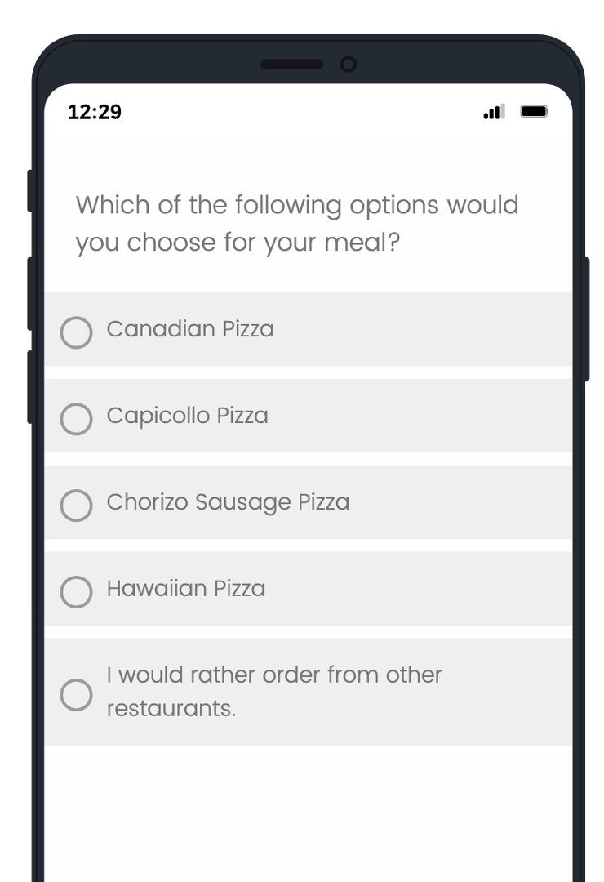
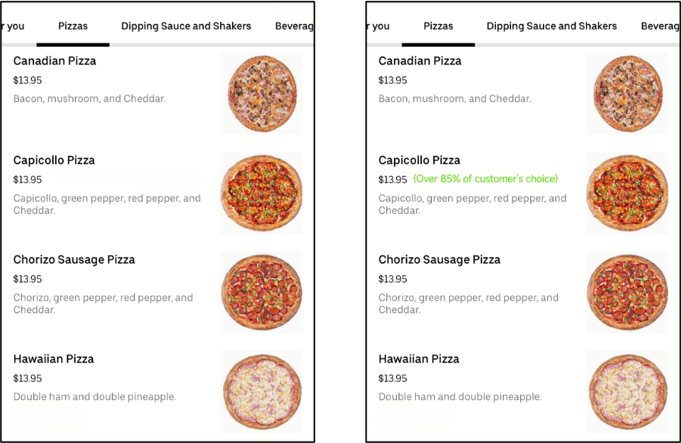
Method
- Online Survey
Control Group
Test Group
Notes:
In order to verify these hypotheses, we are going to have an online survey-based experiment.
In the experiment, we will show the participants the order page of our delivery app and ask them several questions.
The most important question is, "which pizza would you choose for a meal?" There are 4 pizzas on this page. Participants can choose one of them, or choose "not to make an order".

Slide 8
Method
- Online Survey
control
Control Group
Test Group
Stimuli
Notes:
As you can see, in the control group, there is no extra information on the page. In the test group, there is a label on the name of the second pizza. On the label, it says "over 85% of customer's choice". That's our stimuli.

Slide 9
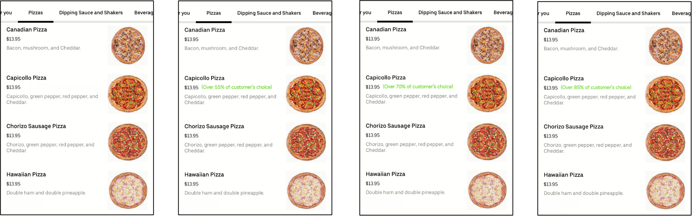
Method
- Online Survey
Control Group
Test Group 1
Test Group 2
Test Group 3
No Label
Over 55% of
customer’s choice
Over 70% of
customer’s choice
Over 85% of
customer’s choice
Notes:
To be specific, we have three test groups with different percentages on the label: 55%, 70%, and 85%.
That is to say, the 301 participants will be divided into 4 groups randomly. We are going to find out if the label makes any significant difference.

Slide 10
Method
- Measuring
Order conversion rate (Store Level)
Order conversion rate (Store Level)
the number of orders
the number of participants
=
Order conversion rate (Dish Level)
Order conversion rate (Dish Level)
the number of orders of each pizza
the number of participants
=
Notes:
After collecting the data from the participants, we will measure their answers by two important indicators: Order conversion rate at Store Level and Dish Level. In short: do we have more orders? Do we sell more pizza with the label?
We will test our 7 hypotheses one by one. For example, for hypothesis 1, we will compare the Order conversion rate at Store Level between the control group and the test group with the chi-square test. The methods used for each hypothesis are listed in Appendix-4.

Slide 11
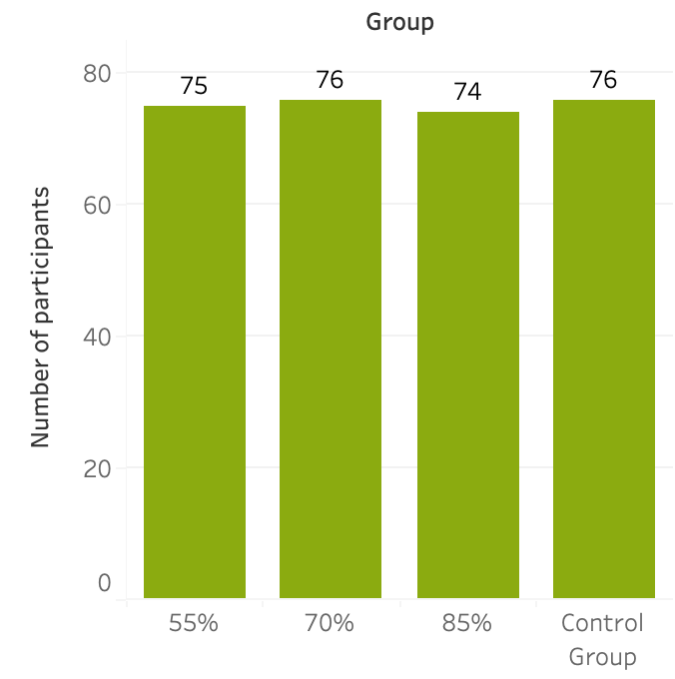
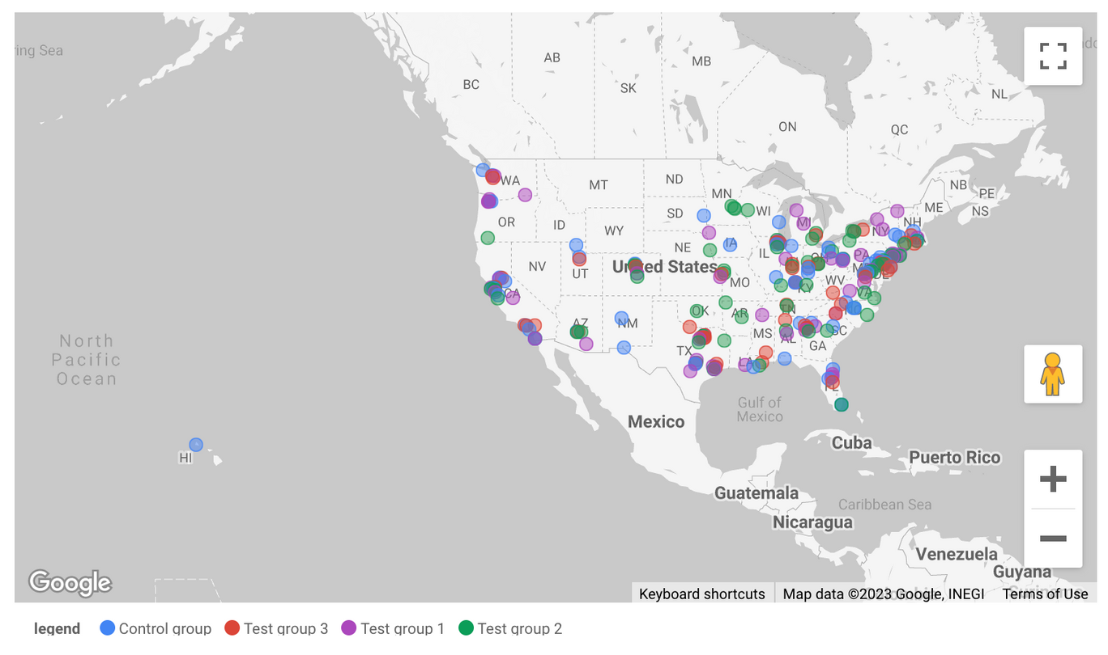
Glance on Data
- 301 Participants
Survey Responses
Geographic Distribution
Notes:
After the experiment, we obtained the data from the 301 participants. As I said before, the participants were assigned into 4 groups randomly. Their geographic distribution in each group is also random.
We will test our hypotheses by analyzing these data.

Slide 12

Hypothesis 1
Adding a popularity label beside the dish brings impact on the conversion rate of making an order
 | Total Number of Participants | Conversation Rate
With Label (treatment) | 225 | 89.33%
Without Label (controlled) | 76 | 92.11%
The test employed: Chi-squared
p = 0.4855
Conclusion:
For the overall conversion rate, no significant impact was brought by the label
Notes:
The first hypothesis we want to test is if adding a popularity label beside the dish would increase the overall conversion rate of making an order
From the left table, we can see the sample size for the treatment group is 225 consisting of three test groups and the control group is 76 without labels. Since we need to compare the proportion between the number of ordering and all responses, a chi-square test is appropriate here. As we see from the output, the p-value is around 0.4855, representing there is no significant difference between the conversion rate with to without labels. Therefore, we can conclude that labels on one dish on the menu won’t bring a higher ordering rate.

Slide 13

Hypothesis 2
Adding a popularity label beside the dish brings impact on the rate of ordering the labeled dish
The test employed: Chi-squared
p = 0.1029
 | Total Number of Participants | Rate of Ordering Labeled Dish
With Label (treatment) | 225 | 29.33%
Without Label (controlled) | 76 | 19.73%
Conclusion:
The popularity label makes a marginally significant difference in the ordering rate of the labeled dish.
Power = 0.34. Running the experiment 100 times, we would make the same conclusion 34 times.
If we want to reach 0.8 power, 654 observations and 221 observations are required for the treatment group and the control group.
Notes:
The second hypothesis we tested is if adding a popularity label beside the selected dish would increase the rate of ordering the selected dish
Since we only measure the ordering rate for the selected dish, the figures in the left table are around 29.33% and 19.73% for the treatment and control groups.
Same as before, we need to compare two proportions, and a chi-square test is used. We discovered that the p-value is 0.1029, indicating a marginally significant difference between the order rate for the selected dish with and without labels.
We also conduct a power test, and the power is only 0.34. Meaning when we run the experiment 100 times, only 34 times we can make the same conclusion that the difference due to the label is significant.
From our further study in power analysis, we found out that If we want to reach power at 0.8, we will need 654 observations in the treatment group and 221 observations in the control group. Appendix 2 shows the power analysis details

Slide 14
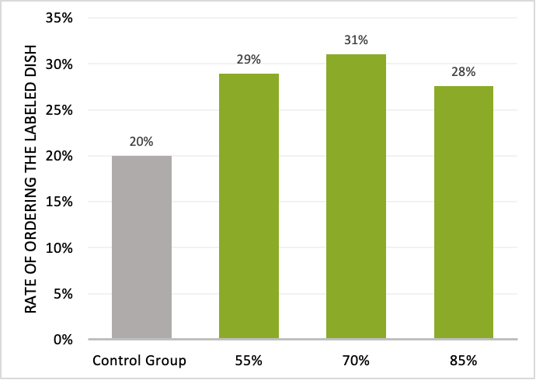
Hypothesis 3
The magnitudes of labels (55% vs 70% vs 85%) make a different impact on the rate of ordering the labeled dish
The test employed: Chi-squared
55% vs. 70%: p = 0.9
55% vs. 85%: p = 0.9
70% vs. 85%: p = 0.8
Conclusion:
There is no significance difference of impacts brought by labels with different labels
Notes:
Our third hypothesis test was whether the different magnitudes of labels (55%, 70%, and 85%) would have a significant impact on the rate of ordering the labeled dish.
We visualized the difference in ordering rate using the graph on the left.
To investigate this hypothesis, we conducted chi-squared tests and found that the p-values for the tests between test groups 1 and 2, test groups 2 and 3, and test groups 3 and 1 were all between 0.8 and 0.9. These results indicate that there is no significant difference in the conversion rates for the selected dish across the three test groups.

Slide 15
Interaction Analysis
Hypothesis 4
Hypothesis 5
Label impact depends on Income level
Label impact depends on Education level
Hypothesis 6
Extra hypotheses
Label impact depends on food delivery app usage frequency
Label impact depends on demographic information such as gender and marital status
Notes:
(Please see Appendix-3. Hypothesis results)
We were also interested in whether the effect of the label varied depending on other factors such as income level, education level, frequency of food delivery app usage, and demographic information.
We conducted two-way ANOVA tests with an interaction effect and found that none of the interaction terms showed a significant effect. This indicates that these factors do not affect the rate of ordering dishes with labels.

Slide 16



Advice & Limitations
Recap
Advice
Limitations
Labels on selected dishes would significantly increase the order rate of the selected dishes while wouldn't impact the total order rate
Implement the strategies if store owners want to boost the sales for the particular item
The power of hypothesis testing is small (~0.34)
A larger sample size could bring higher power
Limited data
Notes:
Based on our online survey experiment and hypothesis tests, we conclude that displaying a label indicating 55%, 70%, or 85% of customers' choices alongside a selected dish has a significant positive impact on the order rate of that dish while no negative impact on the overall order rate.
Therefore, we recommend that store owners consider adding popularity labels to their delivery app menus as a means of increasing the order rate of specific items.
However, our survey has a relatively small sample size, which limits the amount of data available for analysis and reduces the power of our hypothesis test. To increase the power of our hypothesis test, we should consider conducting a survey on a larger sample size group.

Slide 17

Thank you !
Choose with confidence, taste with satisfaction
-the key ingredients for a delicious meal

Slide 18
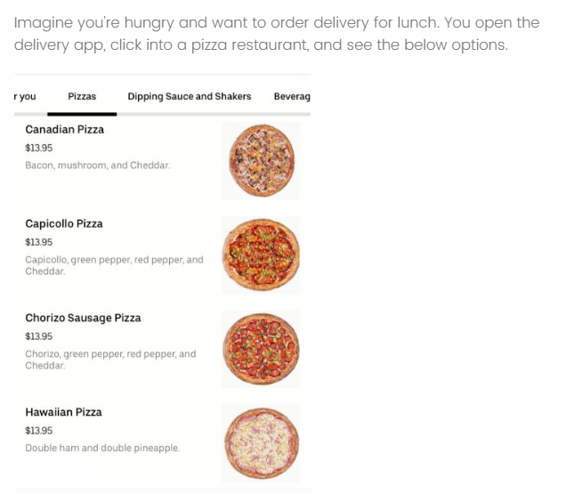
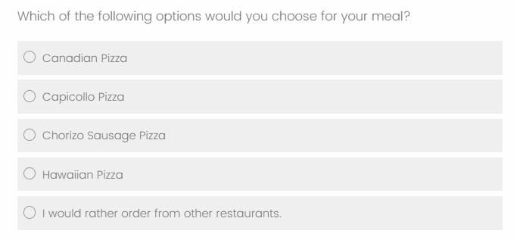
Appendix 1
- Survey Questions (DV,IV)
Notes:
Each participant would see a different page for the menu. Four options: no label, label with 55%, 70%, and 85%.
The first questions would collect dependent variable and independent variables

Slide 19
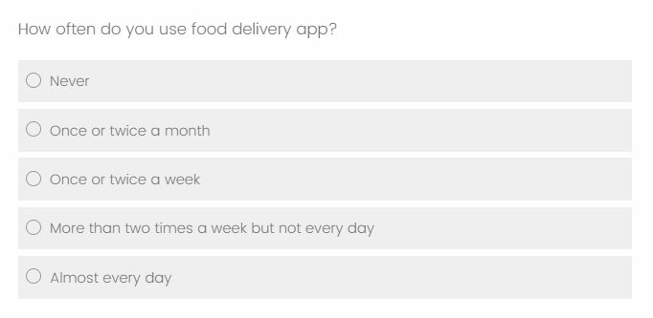
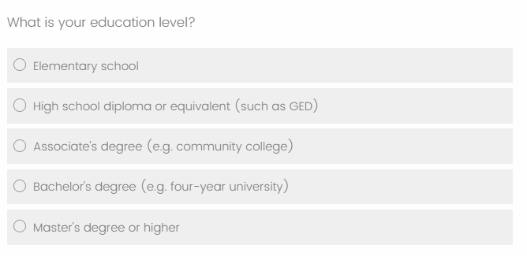
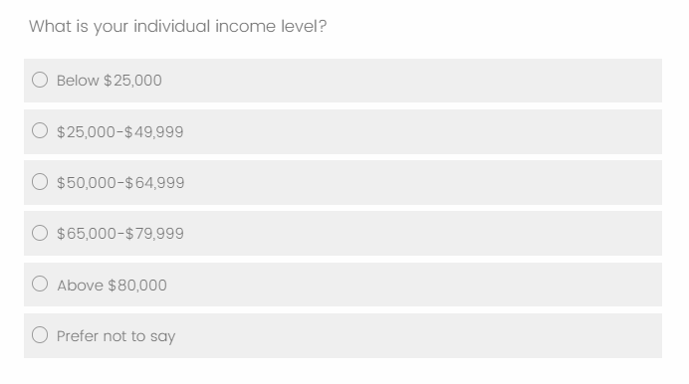
Appendix 1
- Survey Questions (moderators)
Notes:
We plan to collect information for three moderators: income level, education level, and how frequently people on their food delivering apps

Slide 20
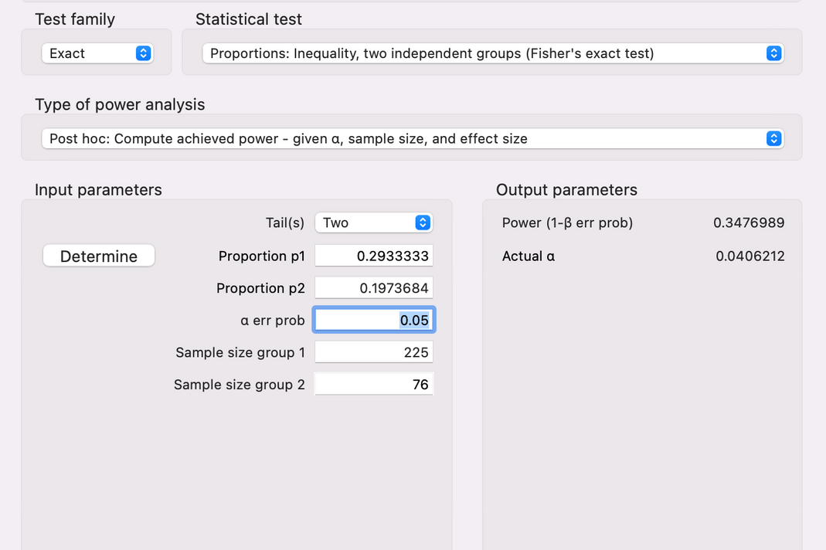
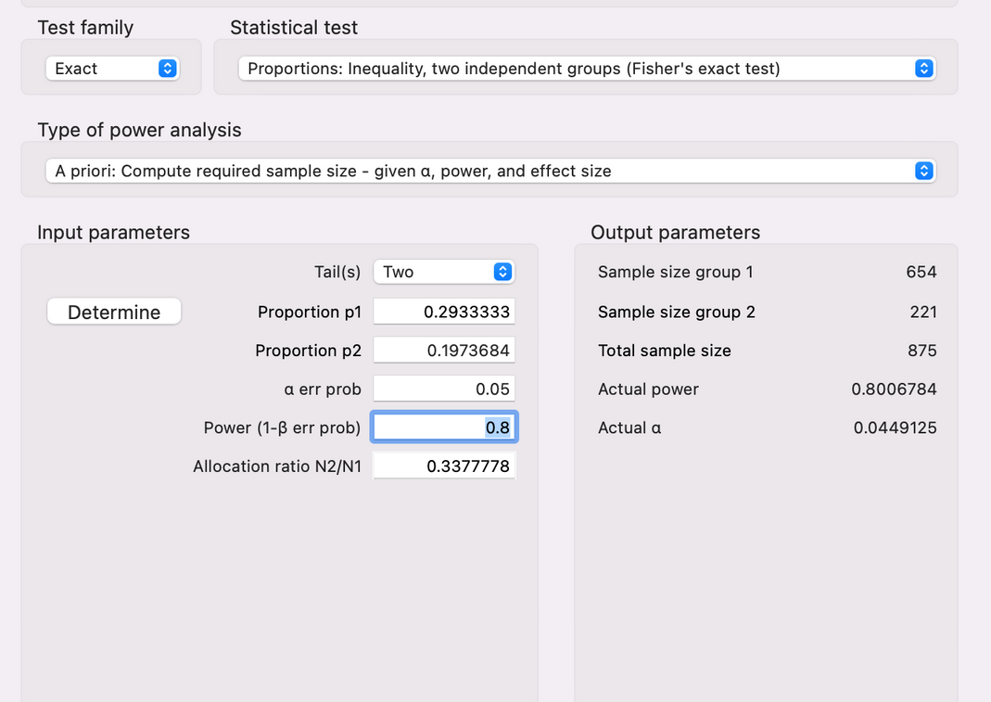
Appendix 2
- Power Anaysis
Power for our hypothesis
Required sample size to get power = 0.8
Notes:
We used the exact test since we have two proportions to compare.

Slide 21
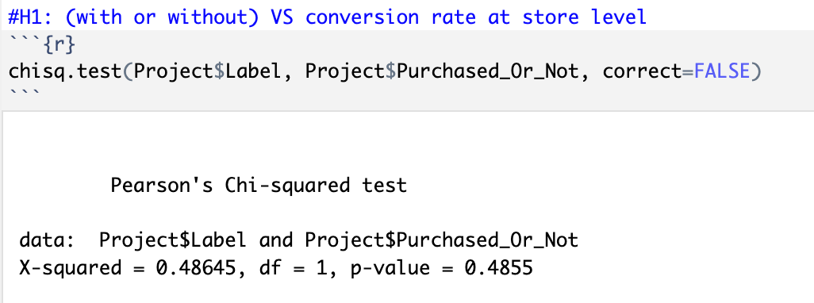
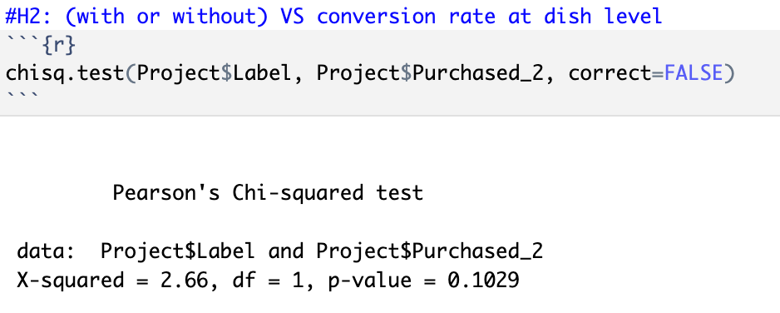
Appendix 3
- Hypothesis results
Notes:
Interpretations are in the slides

Slide 22
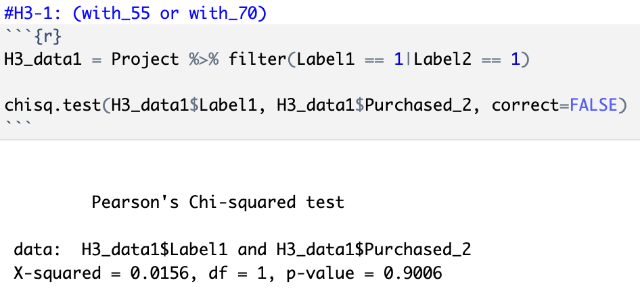
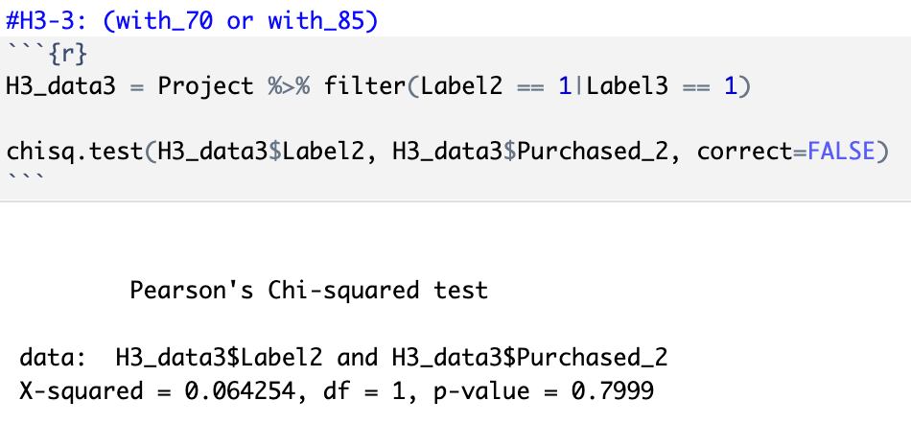
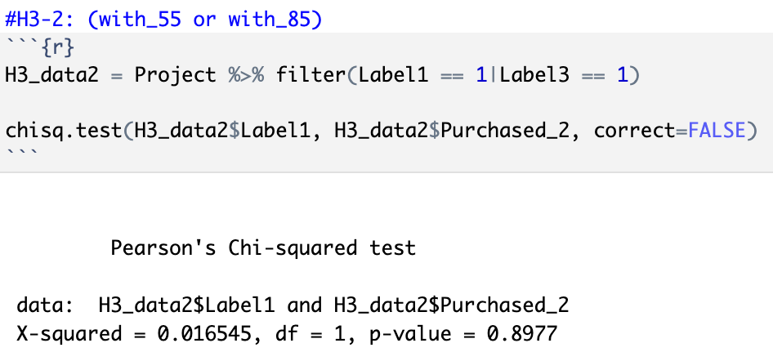
Appendix 3
- Hypothesis results
Notes:
Interpretations are in the slides

Slide 23
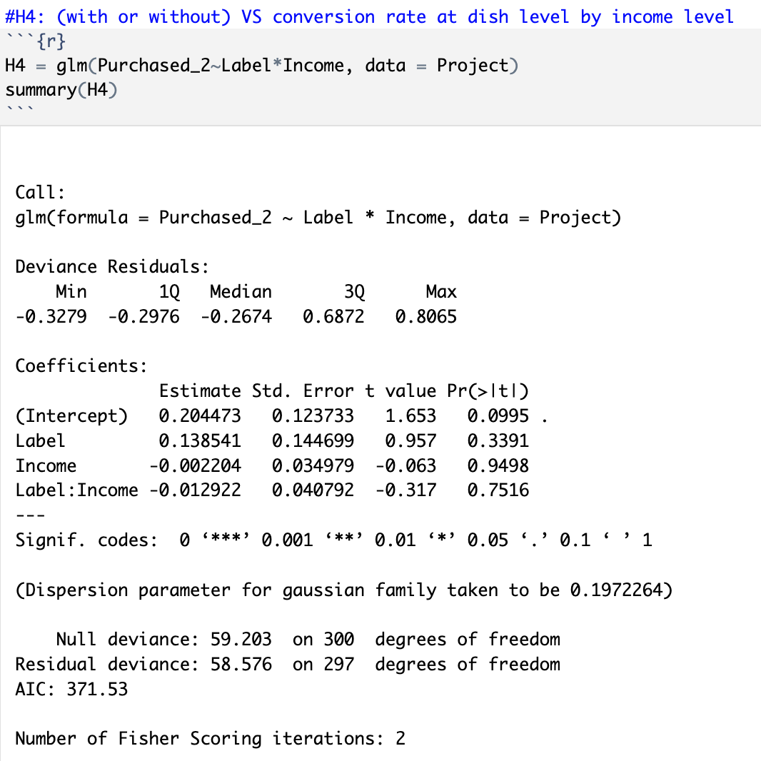
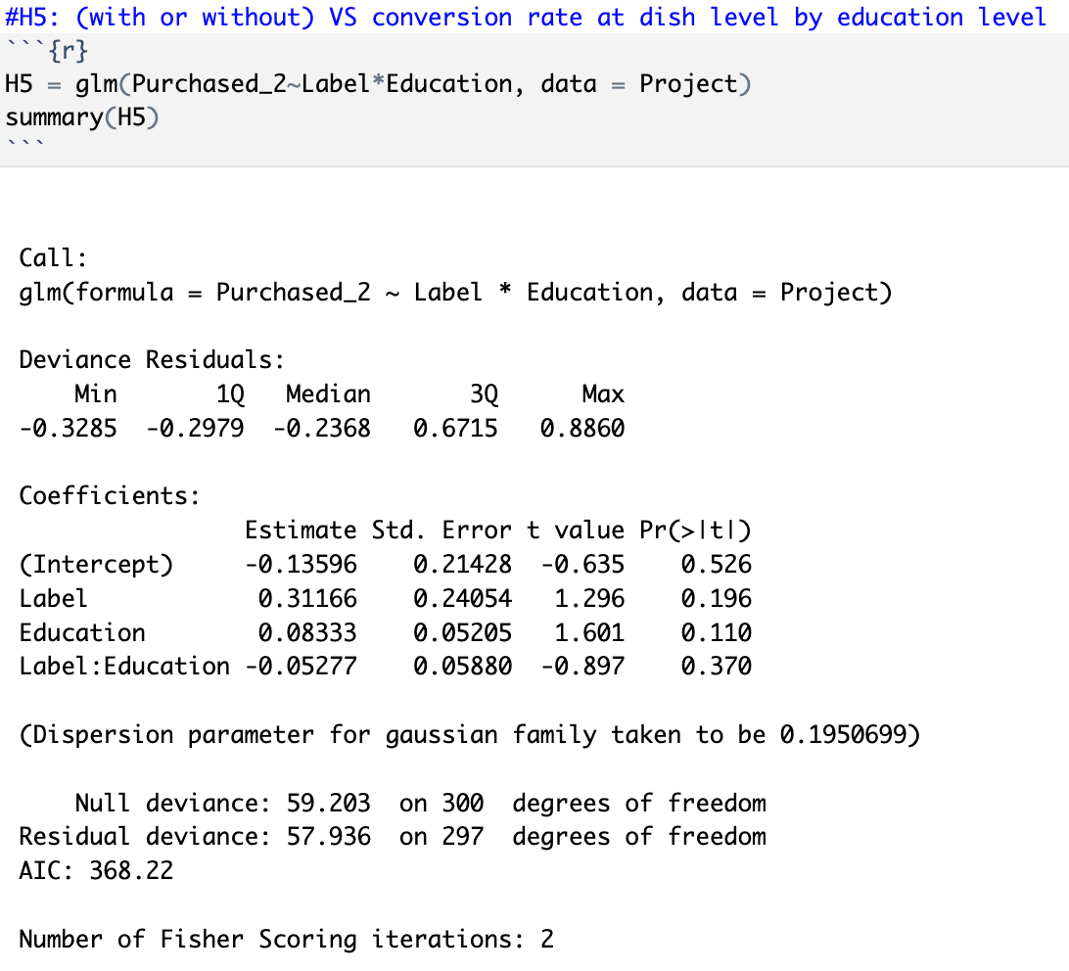
Appendix 3
- Hypothesis results
Notes:
We focused on the interaction p-value. For the interaction with income level, the p-value is 0.752, representing the dependency assumption is not significant. Similar observation and conclusion can be made for the interactions of education level and frequency

Slide 24
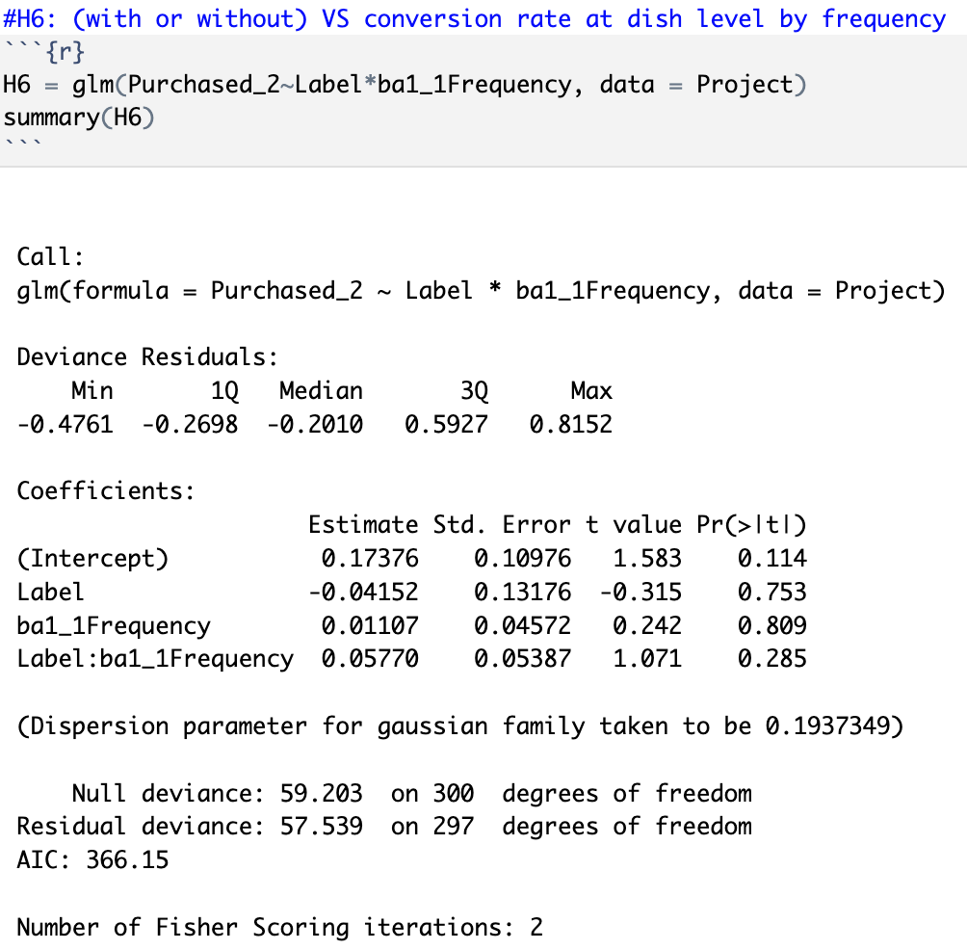
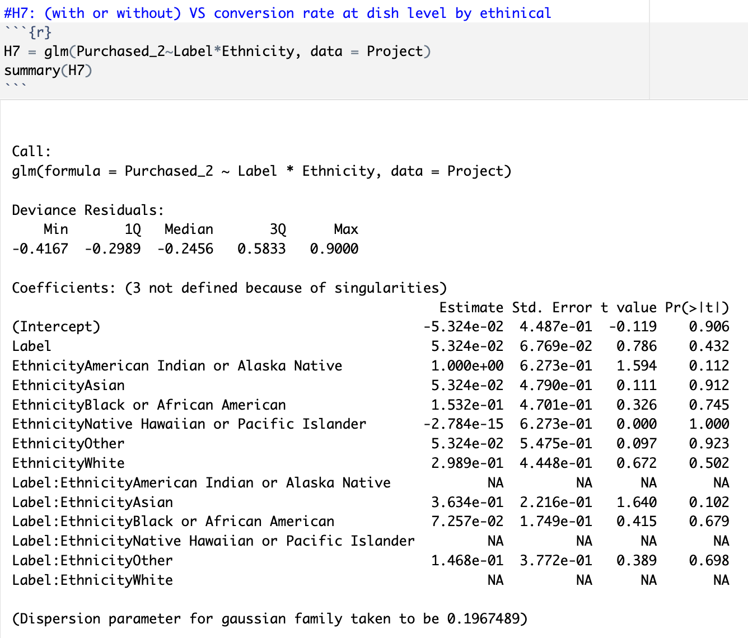
Appendix 3
- Hypothesis results

Slide 25
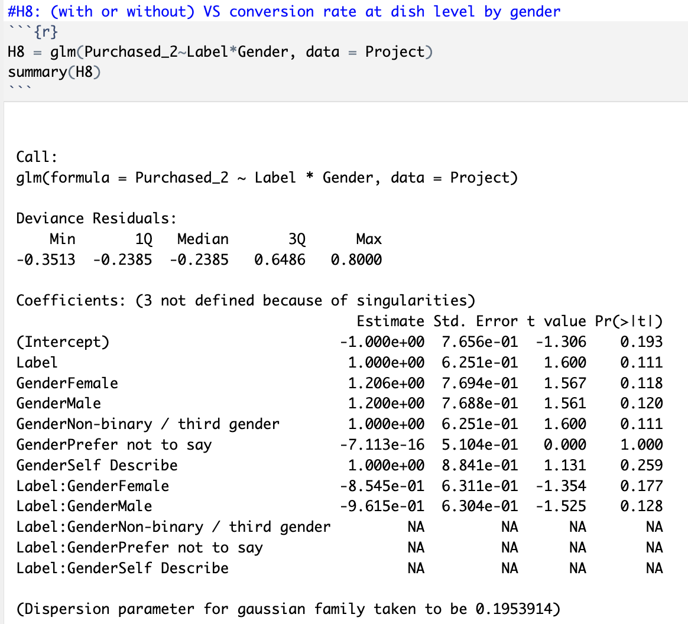
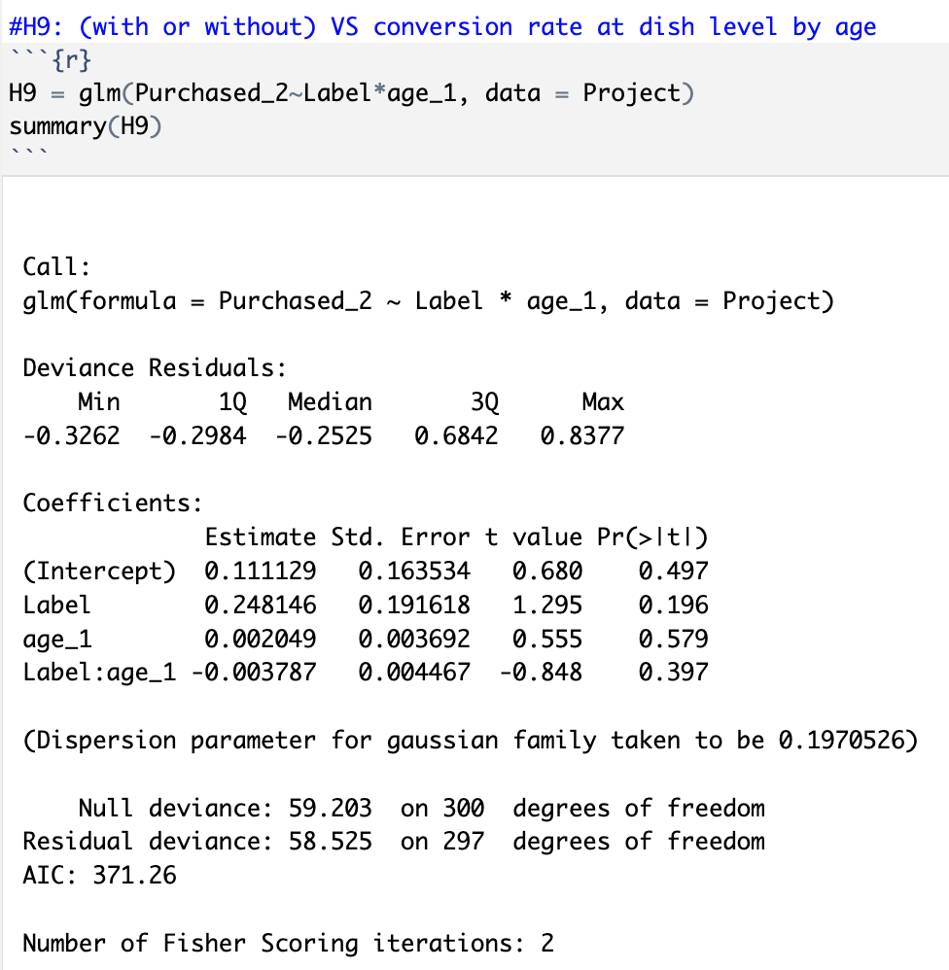
Appendix 3
- Hypothesis results
Notes:
We did further tests on demographic information interaction. We tested the label impact interaction with ethnical, gender, age, and marital status. None of them have a p-value smaller than 0.2. Therefore, we concluded that the information doesn't have an interaction impact with the label effect

Slide 26
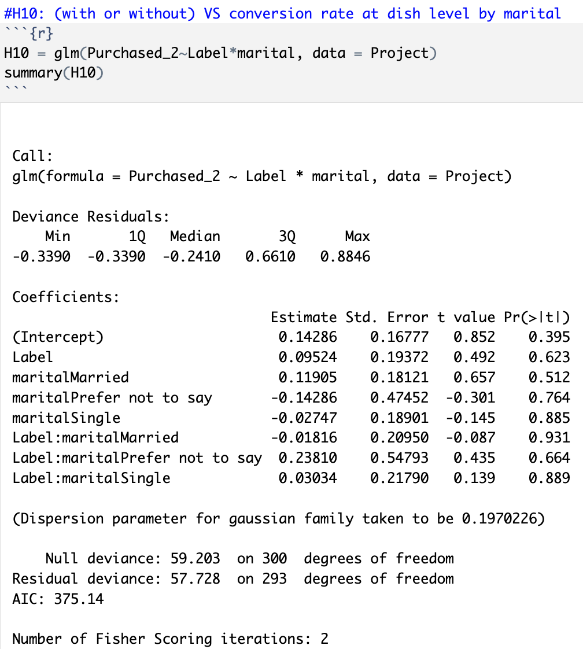
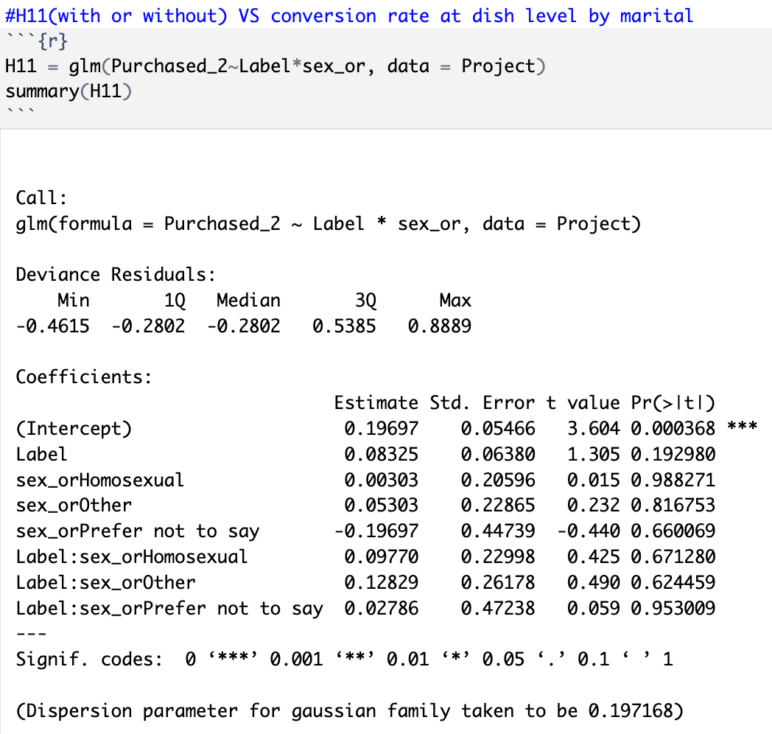
Appendix 3
- Hypothesis results

Slide 27
Appendix 4
- Method
Hypothesis |  | Groups involved | Variable involved | Method
H1 | With or without label will affects conversion rate (Store Level) | Control Group VS. Test Group | Order conversion rate (Store Level) | ﻿Chi-Square test
H2 | affects conversion rate (Dish Level) | Control Group VS. Test Group | Order conversion rate (Dish Level) | ﻿Chi-Square test
H3 | affects conversion rate from different label magnitude | Test Group 1 VS. Test Group 2; Test Group 1 VS. Test Group 3; Test Group 2 VS. Test Group 3; | depends on the validity of Hypothesis 1 & Hypothesis 2 | ﻿Chi-Square test
H4 | affects conversion rate depending on education | Control Group VS. Test Group | depends on the validity of Hypothesis 1 & Hypothesis 2 | ﻿Logistic regression
H5 | affects conversion rate depending on income | Control Group VS. Test Group | depends on the validity of Hypothesis 1 & Hypothesis 2 | Logistic regression
H6 | affects conversion rate depending on ordering frequency | Control Group VS. Test Group | depends on the validity of Hypothesis 1 & Hypothesis 2 | ﻿Logistic regression
H7 | affects conversion rate depending on other demographics | Control Group VS. Test Group |  | ﻿Logistic regression

